Slide 1

ADAMS COUNTY WATER STUDY UPDATE
REGIONAL ECONOMIC ADVANCEMENT PARTNERSHIP (REAP)
APRIL 11, 2024

Slide 2
Adams County Water Study Phases
  Phase One:
    Community Water Baseline Report
      Finalized September 2023
  Phase Two:
    Water Master Plan
      Begin early summer 2024
1

Slide 3
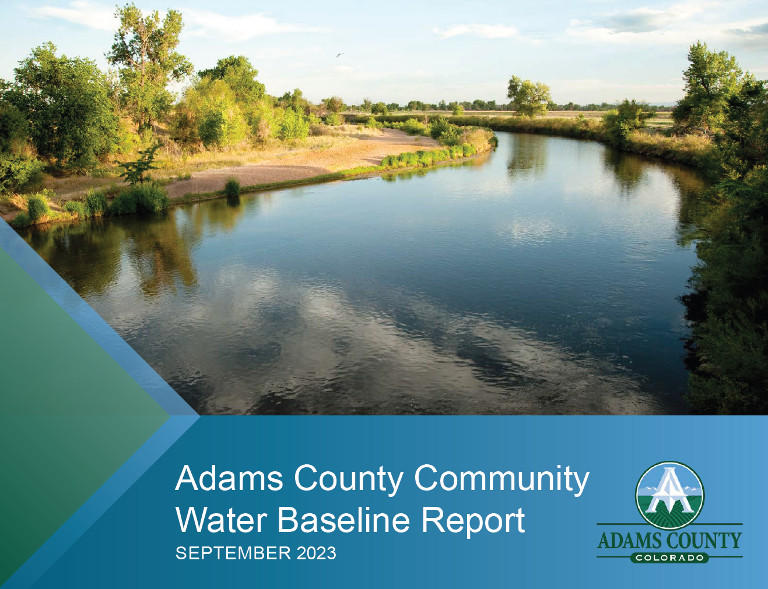
Adams County Water Baseline
Aggregate water supply information for Adams County
Inventory of largest water providers
Key risk and vulnerabilities
Data gaps to create a complete picture of Adams County water profile
Inform Water Master Plan
2

Slide 4
Adams County Water Baseline
Who was involved?
Adams County Staff
Brendle Group
Work Session Attendees
Arapahoe County
Aurora Water
City of Brighton
City of Thornton
City of Westminster
Crestview Water and Sanitation District
Denver Water
Hyland Hills Parks and Recreation District
Jehn Water Consultants
North Washington Street Water and Sanitation District
South Adams County Water and Sanitation District
Todd Creek Village Metropolitan District
3

Slide 5
Adams County Water Baseline
Why?
The County is growing.
Importance of integrated land use and water management.
Drought and aridification’s impact on water supplies.
4

Slide 6
Adams County Water Baseline
Methodology
Surface and Groundwater Data & Analysis
Water Provider Information Data & Analysis
Water Provider Work Sessions
Analyzed data from the Colorado Decision Support System
Gather and analyzed publicly available plans & information for 15 largest providers
Held 2 work sessions to get feedback
5

Slide 7
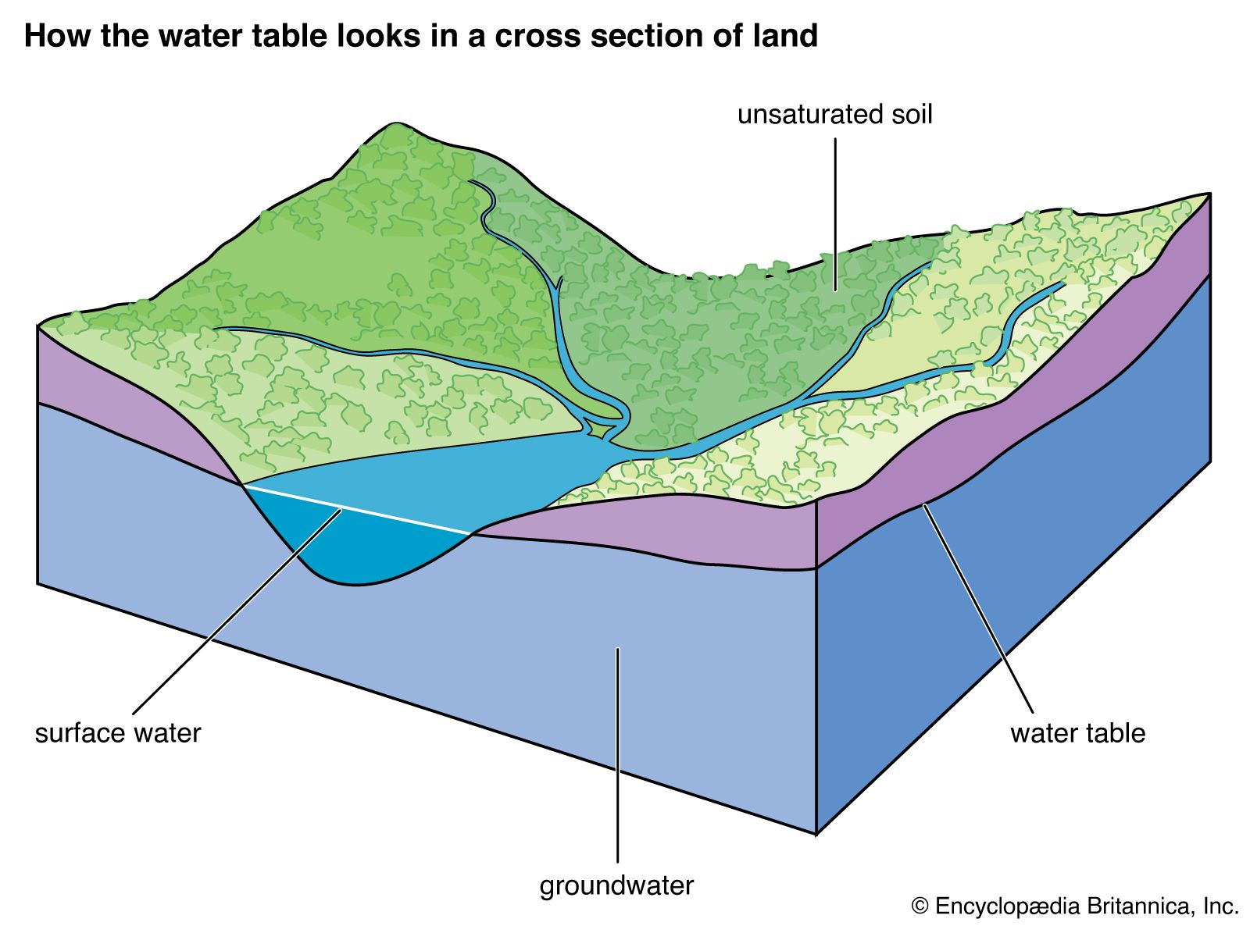
Adams County Water Baseline
Where does County water come from?
Surface water or streams
Groundwater that is hydrologically connected to streams
Groundwater that is not hydrologically connected to streams
76 Water Providers
24 primarily reliant on surface water
52 primarily reliant on groundwater
6

Slide 8
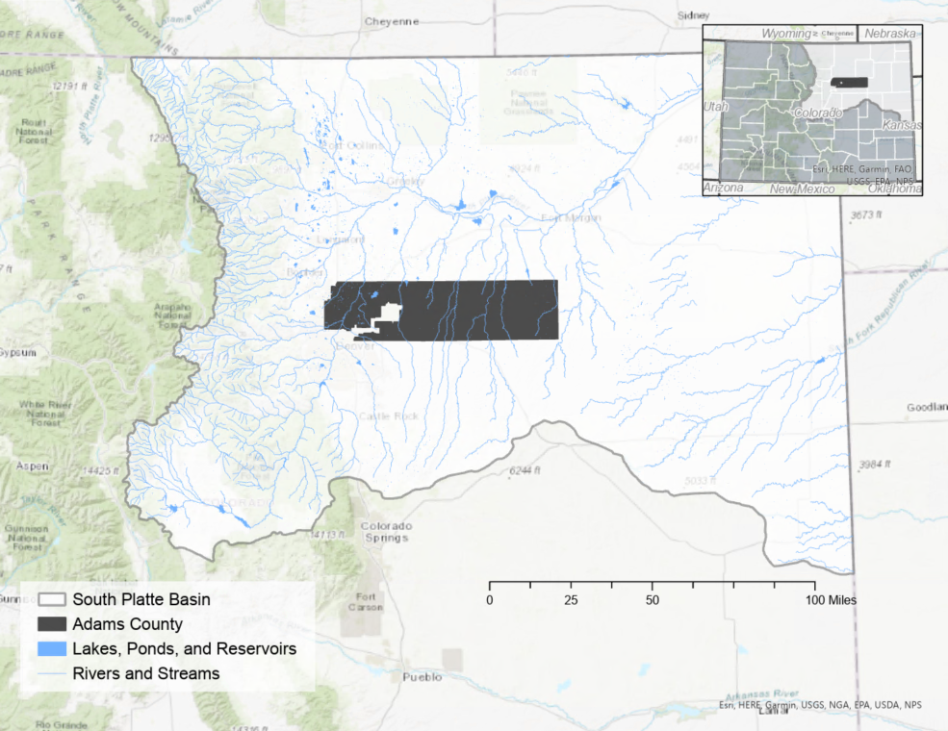
Adams County Water Baseline
Surface Water
Located in the South Platte Basin.
Over 4,000 water rights administered under the prior appropriation system.
Diversion volumes have increased by 341% between 1980 and 2021.
7

Slide 9
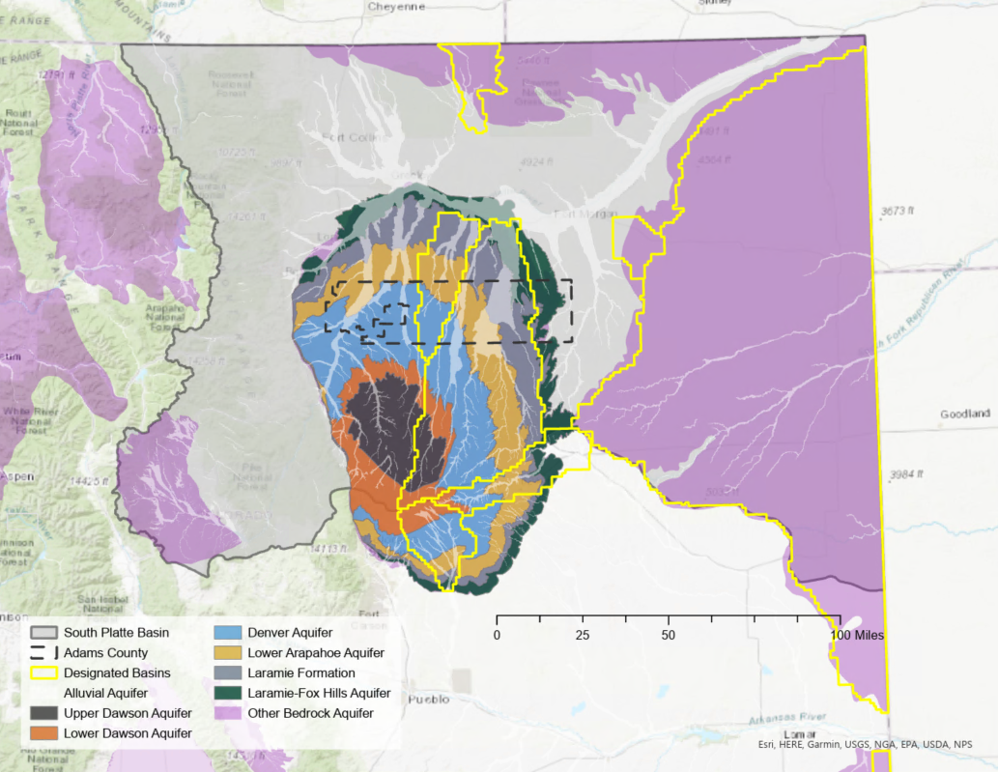
Adams County Water Baseline
Groundwater
Located in the Denver Basin, with two Designated Ground Water Basins.
Over 14,000 constructed well permits.
40% of well permits are for domestic uses.
8

Slide 10
Adams County Water Baseline
Adams County’s Largest Water Providers
Name | Source Type
City of Aurora | Surface Water
City of Thornton | Surface Water
City of Westminster | Surface Water
South Adams County Water Sanitation District | Groundwater
City of Brighton | Groundwater Under the Influence of Surface Water
City of Northglenn | Surface Water
Crestview Water and Sanitation District | Purchased Surface Water
North Washington Street Water and Sanitation District | Purchased Surface Water
City of Federal Heights | Groundwater
Todd Creek Village Metro District | Groundwater Under the Influence of Surface Water
Town of Bennett | Groundwater
North Pecos Water and Sanitation District | Purchased Surface Water
Wikiup Mobile Home Park | Groundwater
Strasburg Water and Sanitation District | Groundwater
9

Slide 11
Adams County Water Baseline
Water Risks and Vulnerabilities
Population Growth
Water Quality
Climate Change Unknowns/Uncertainty
Wildfire
Equity Considerations
Infrastructure & Approval Processes
10

Slide 12
Adams County Water Master Plan
Build upon the Water Baseline Study
  Inform better decision making in the future
  Build partnerships with water providers and municipalities
  Landscaping and other water efficiency best practices on private and public properties
    Education, program development, efficiency opportunities for agriculture
Data Gaps to Address
  Better understanding of self-supplied and ditch water users
  How do findings relate to land use planning and development regulations
  Complete risk and vulnerability assessment.
    Ranks water-related risks and prioritizes solutions for the County
11

Slide 13
Adams County Water Master Plan
Objectives and Tasks
Develop a plan to guide sustainable growth, land use planning, and resiliency within Adams County
Five tasks, including:
  Project design and Kick-off
  Incorporation of Water Baseline and
  data gaps
  Identify key stakeholders, as well as
  rolls and responsibilities
  Landscaping and water-related regulations
  Draft Water Master Plan and endorsement
12

Slide 14
Adams County Water Master Plan
Next Steps
Grant from the Colorado Water Conservation Board in the amount of $397,500
County will match $132,500 for a total of $530,000
RFP Process to hire consultant
Establish stakeholders
Complete the Plan in mid-2025
13

