Slide 2
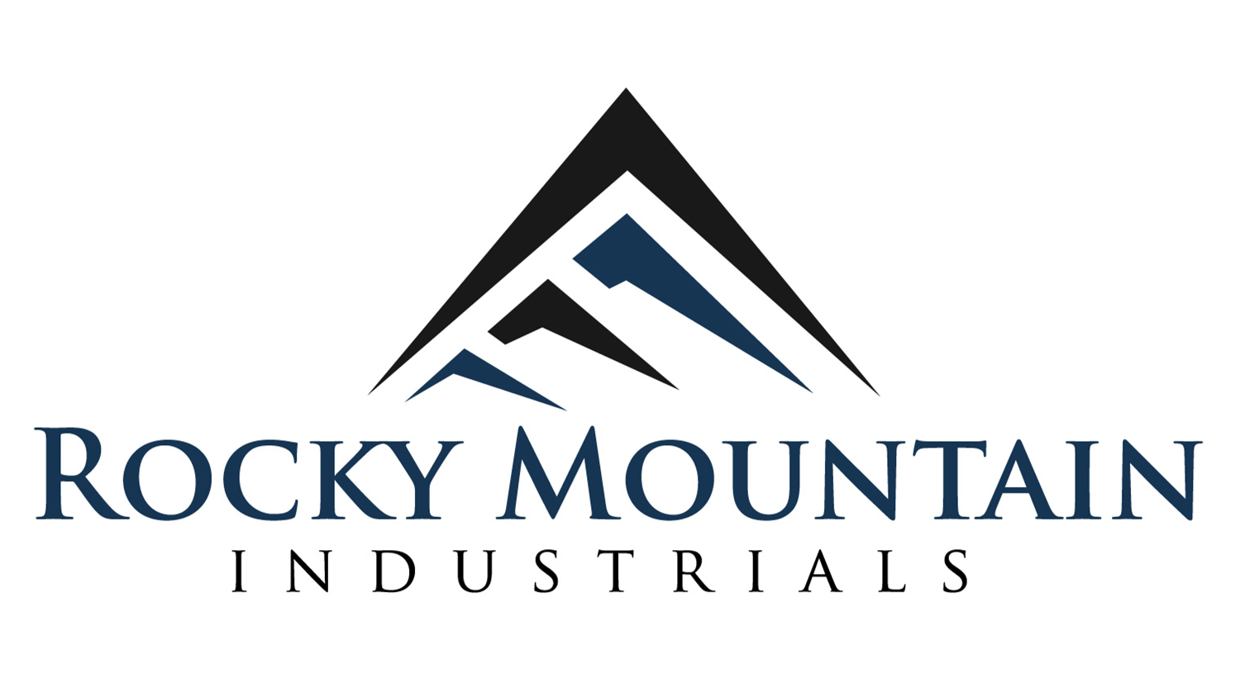
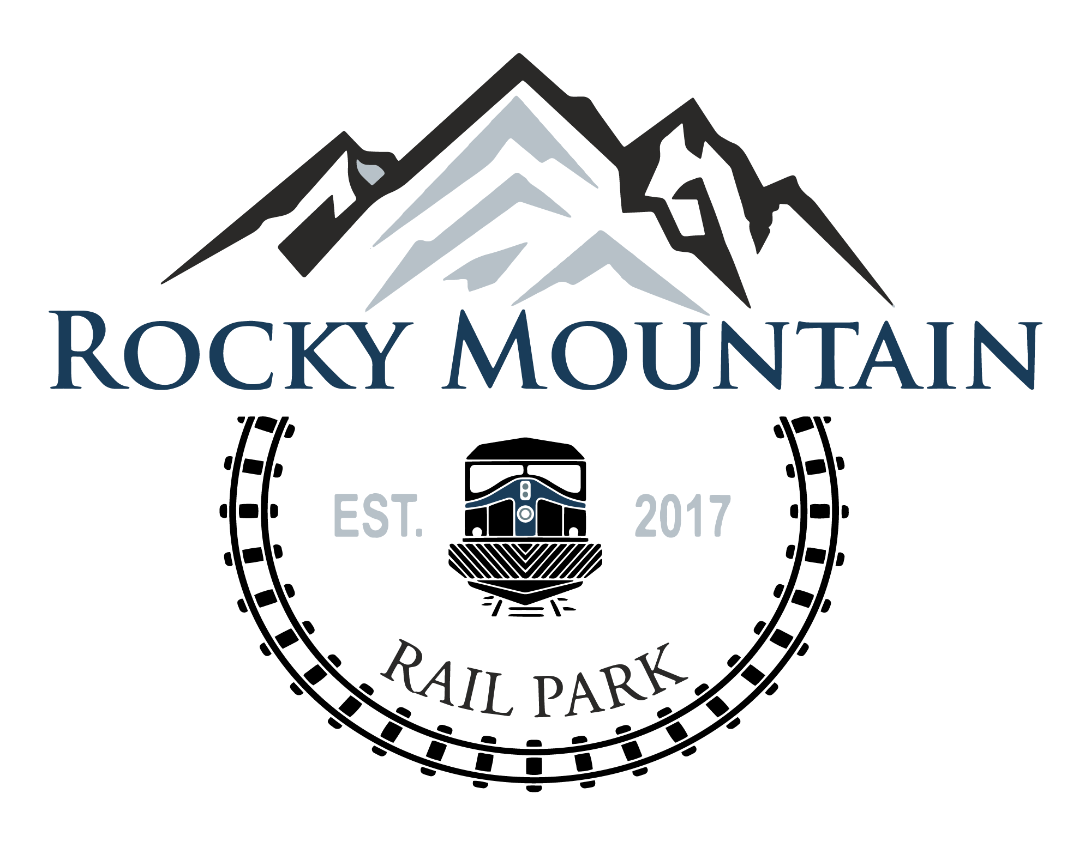
Denver-based company
Develop commercial/industrial projects
Focus on transportation, construction materials, and commodities
Owner of the Rocky Mountain Rail Park
620-acre commercial/industrial rail park
Located 25 miles east of Downtown Denver
Connected to the Union Pacific Railroad
Construction is 95% complete

Slide 3
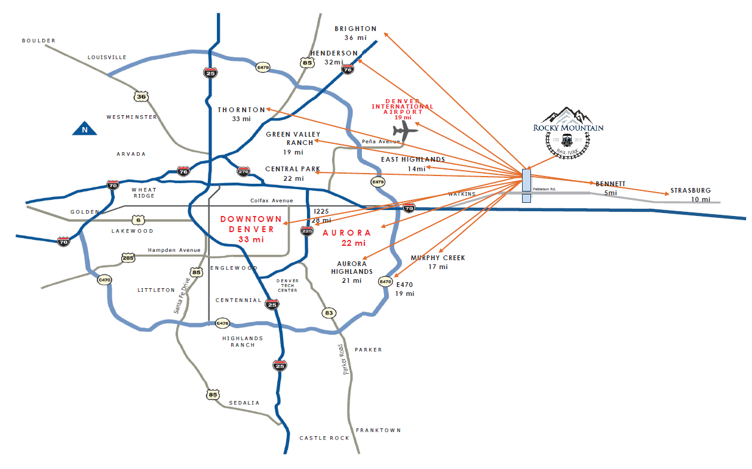
Driving Distances to RMRP
Land purchased in February 2018
Project approved by Adams County BOCC in September 2020
First lot sale in January 2021
Construction commenced March 2021

Slide 4
460 acres of saleable/leasable land, 316 acres remaining
Interested companies are looking to build state of the art flagship facilities
Excellent access to main transportation corridors (road, rail, air)

Slide 5
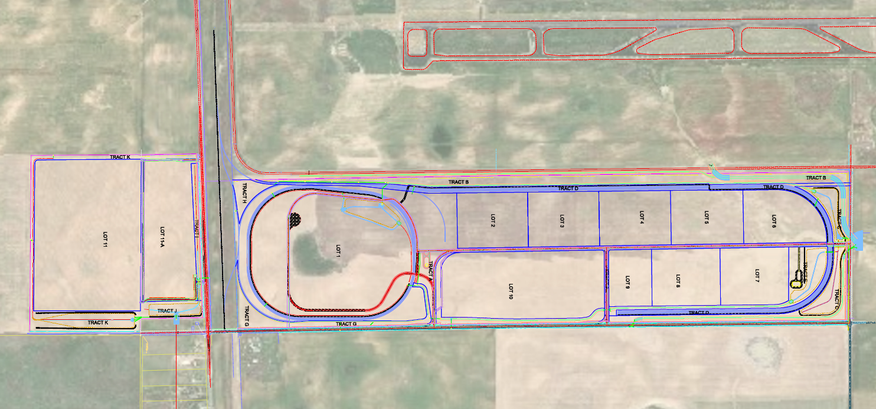
4 miles of rail currently constructed
Up to 16 miles of rail at full buildout
Rail services provided on site by Patriot Rail

Slide 6
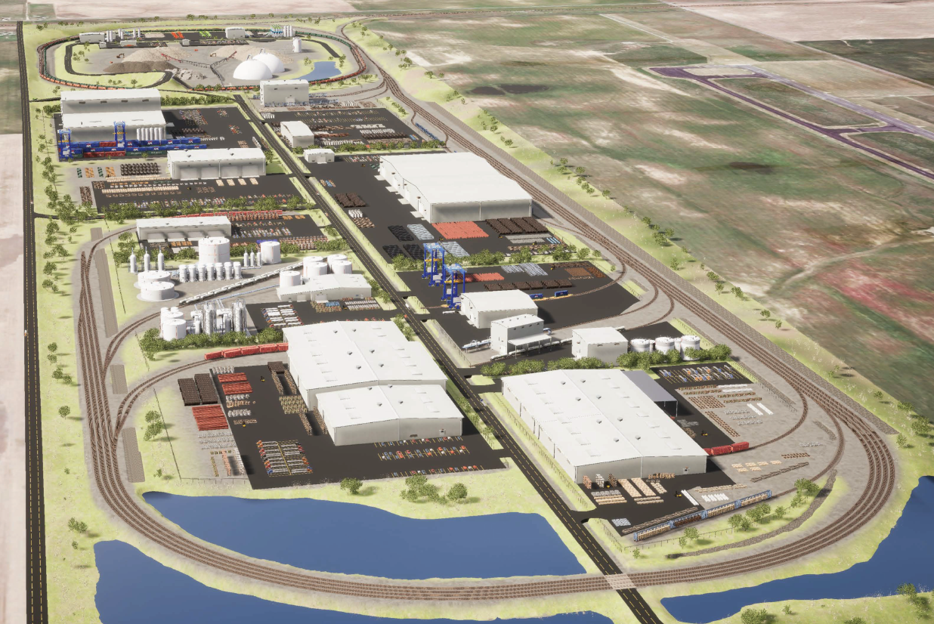
Water and wastewater are provided on site through the Rocky Mountain Rail Park Metropolitan District
Regional stormwater management
Road improvements to adjacent roadways (Colfax Ave. & Peterson Rd.)
500-1000 jobs estimated on site.

Slide 7
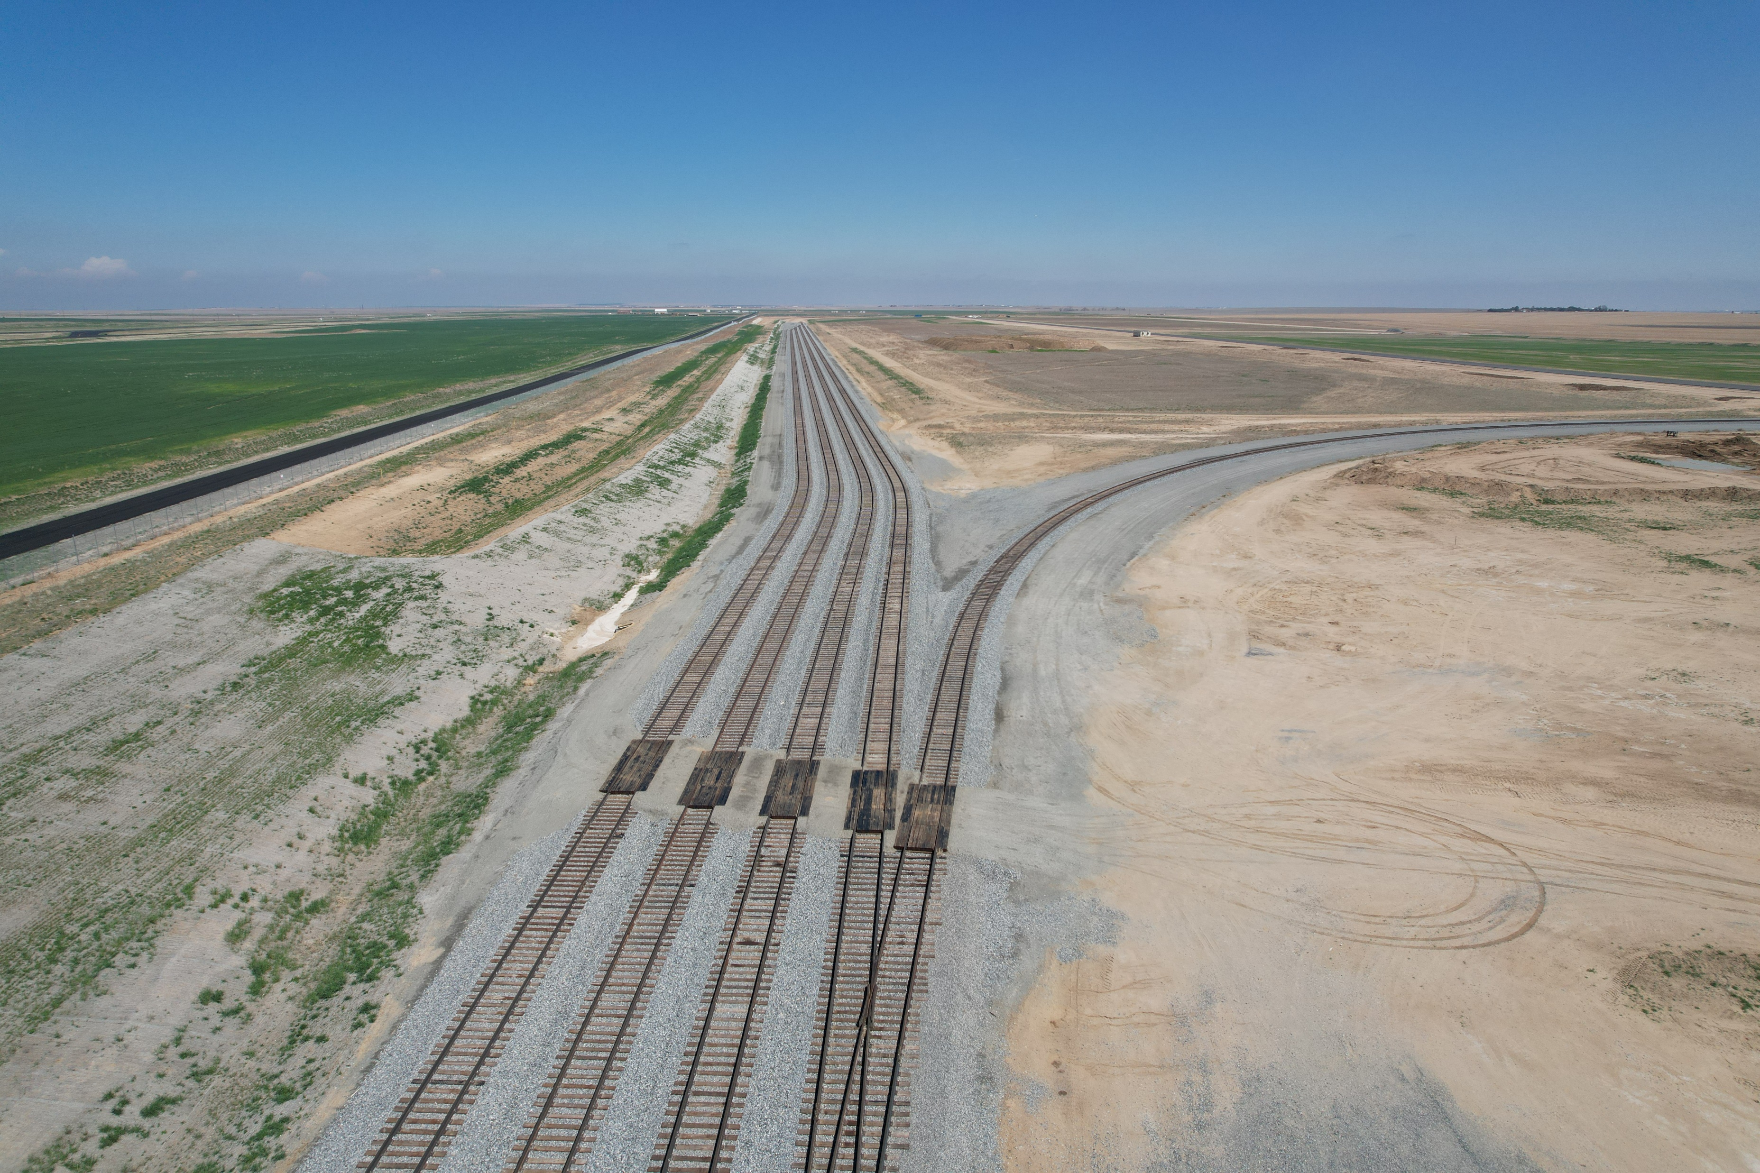
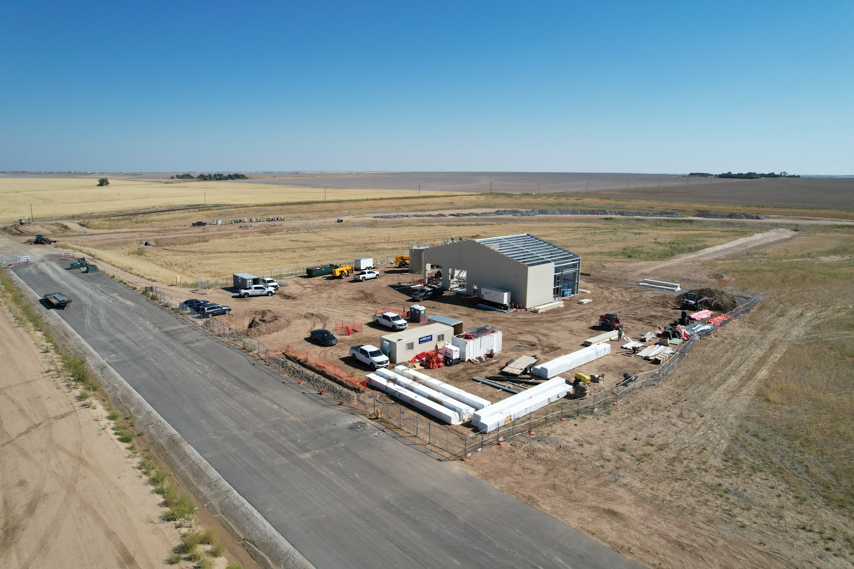
Q&A

