Slide 1
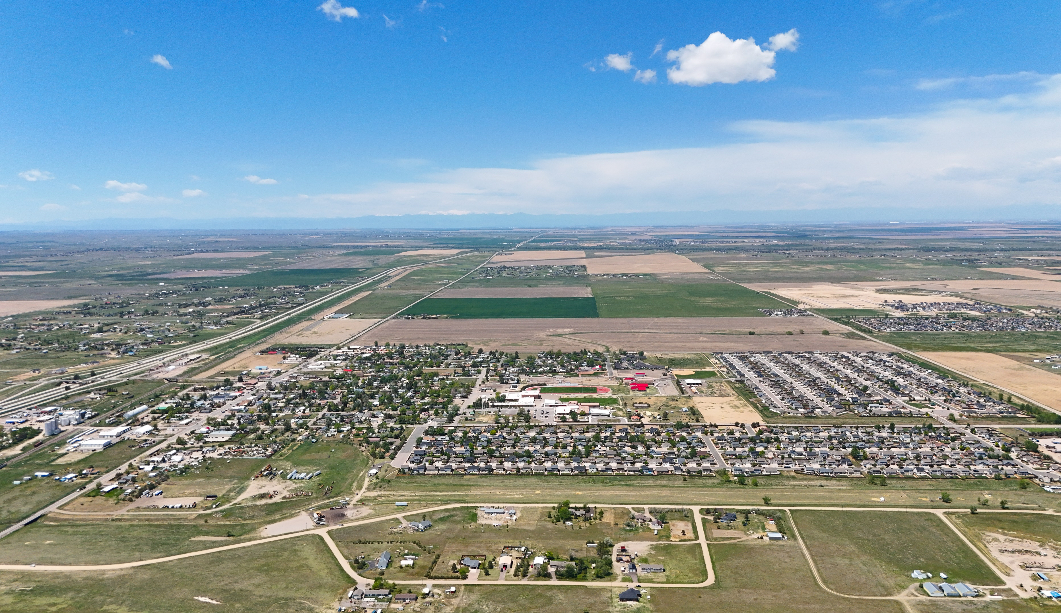


Strasburg 2050 Subarea Plan
Strasburg 2050
Strasburg Subarea Plan

Slide 2
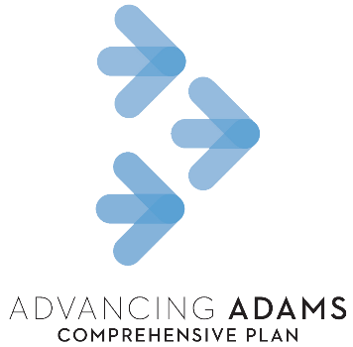
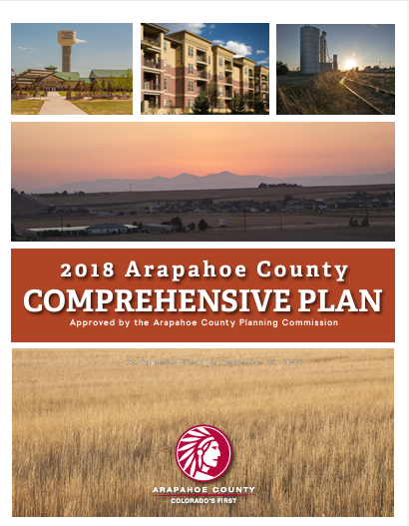
What is a subarea plan?
Welby Plan
Colorado Air and Space Port (CASP) Subarea Plan
Strasburg Subarea Plan
Byers Subarea Plan
Four Square Mile Subarea Plan
2

Slide 3
Planning Process
Existing Conditions
Summer 2024
Plan Development
Fall 2024 – Summer 2025
Plan Adoption
Fall 2025
Plan Implementation
2025-2050
Public Engagement
(ongoing)
3

Slide 4
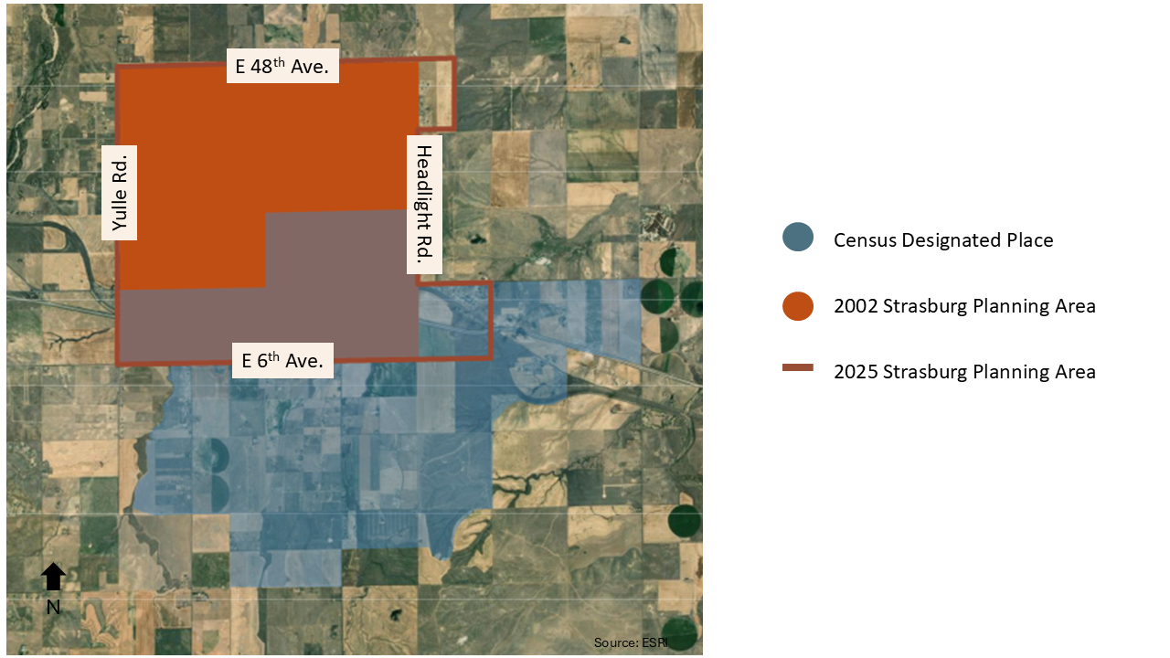
Planning Area
4

Slide 5
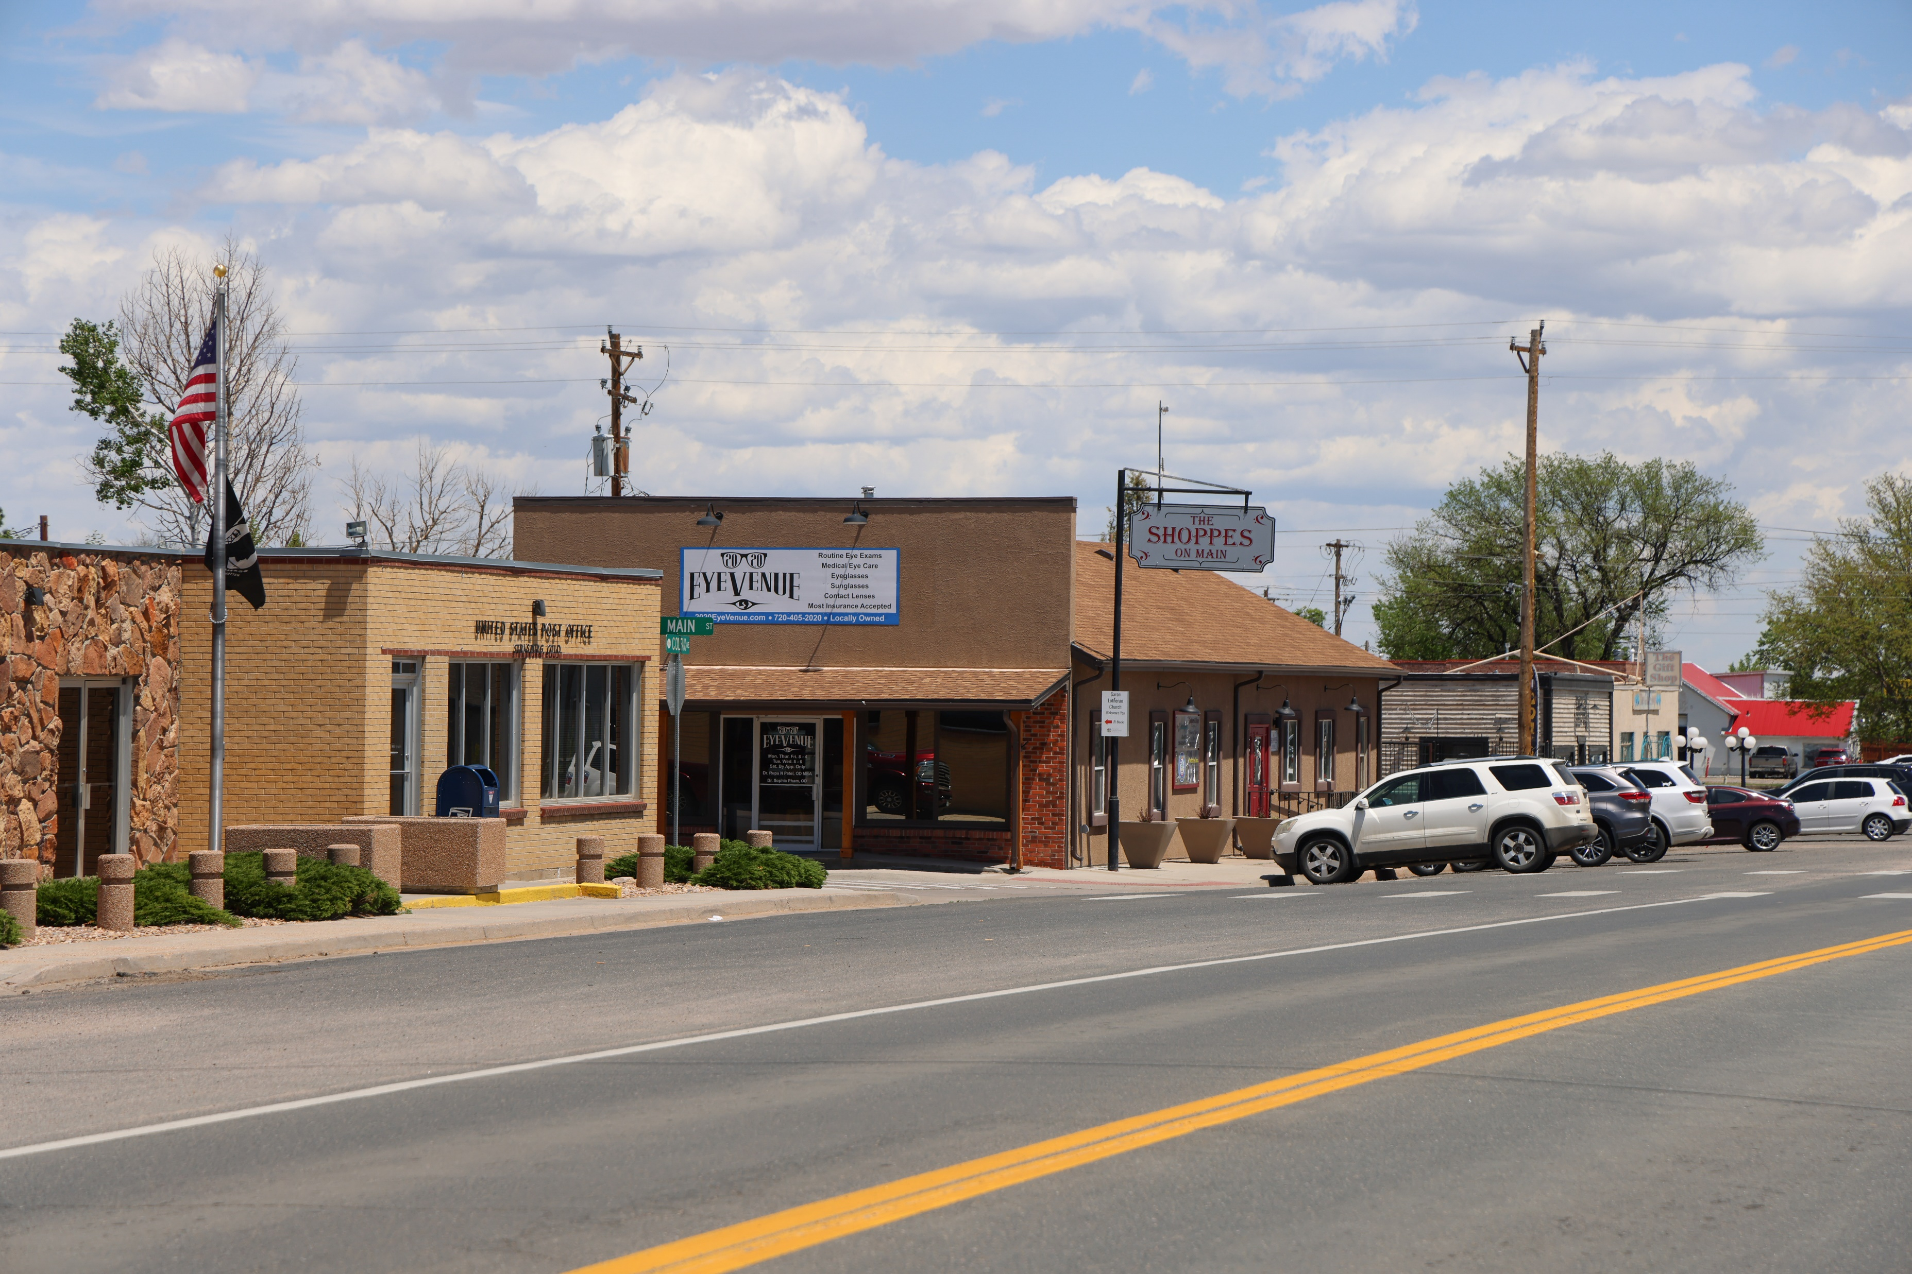
Vision Statement & Guiding Principles
Vision Statement:
Strasburg is a thriving small-town community that cherishes its main-street charm and agricultural heritage, while prioritizing the well-being of its residents. By fostering a vibrant local economy with small businesses, enhancing safe transportation options, and preserving the cherished community spaces, we aim to create a welcoming environment that supports families while maintaining its unique character and ensuring thoughtful growth.
5

Slide 6
Vision Statement & Guiding Principles
Guiding Principles:
Enhance and maintain the charming small-town character and sense of place.
Promote a friendly and safe sense of community.
Steward development intentionally to ensure any growth enhances rather than diminishes existing amenities and services, while protecting our natural resources.
Support and promote local businesses that reflect the community’s values, providing residents with diverse shopping and service options within the town.
Prioritize the maintenance and improvement of roads and develop safe mobility options to connect community members.
Foster strong community ties through cherished spaces, events, and historical preservation, honoring our shared heritage and the stories that connect us.
Actively involve residents in decision-making processes to ensure that all voices are heard.
6

Slide 7
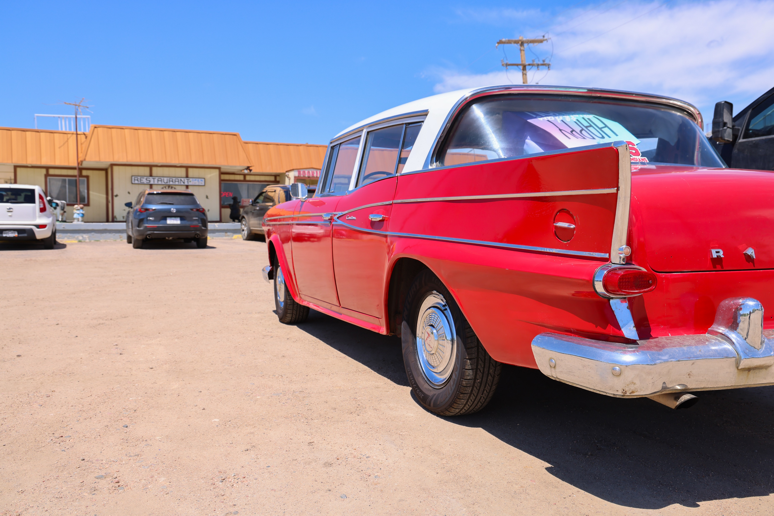
Plan Topics
Economic Development:
Support the Formal Creation of a Downtown Business Association (DBA).
Explore Grant Funding and Incentive Options for Downtown Strasburg (CDOT Main Street Funding, Adams County SPARC Community Resiliency Grant, Remote Work Grant, Community Revitalization Authority, etc.).
Expand and Promote Economic Development Partner Services.
Improve the Downtown Built Environment.
Cultural and Historical Resources:
Work collaboratively with the community to advance the economic, cultural, agricultural, and environmental qualities of the community by preserving, enhancing, and promoting Strasburg’s significant places.
7

Slide 8
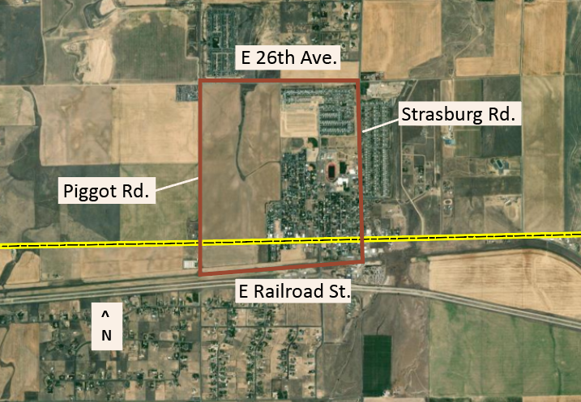
Plan Topics
Land Use and Housing:
Updating future land use map to reflect community goals.
Promoting attainable housing options, including encouraging cooperation between the school district and affordable housing developers.
Encouraging the development of floodplain lands into a connected system of public open spaces.
Creating a defined downtown Strasburg between E 26th Ave, Strasburg Rd., Piggot Rd., and E Railroad Ave.
Source: ESRI
8

Slide 9
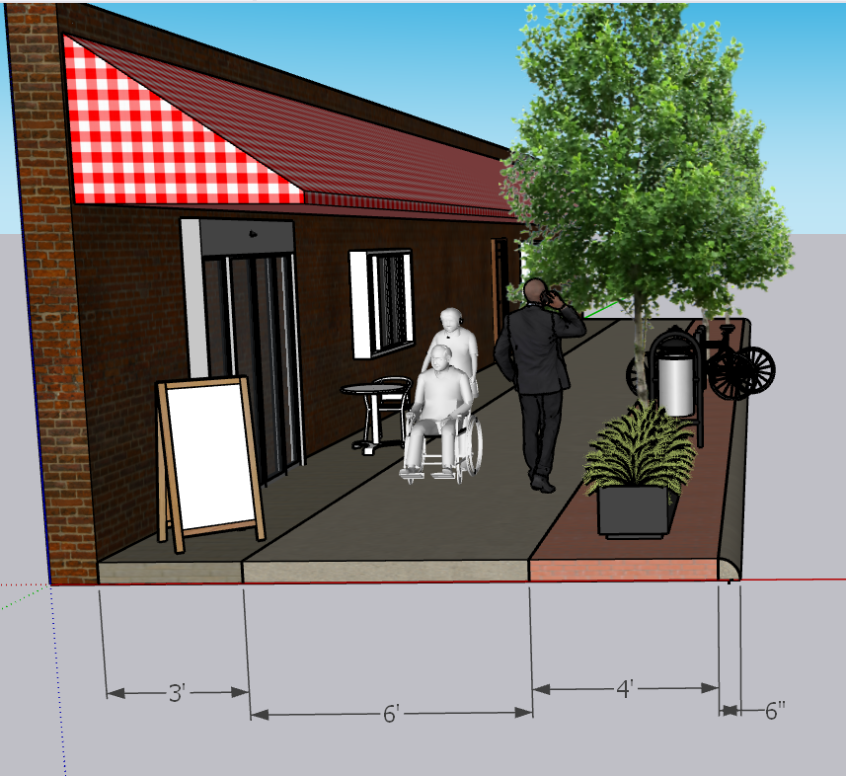
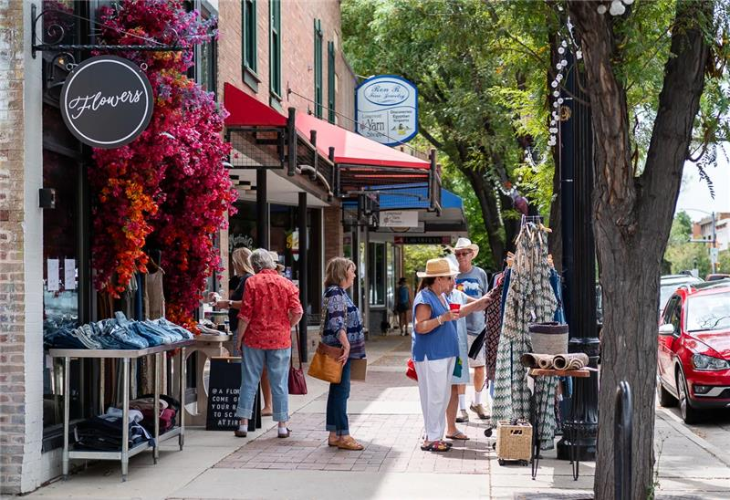
Plan Topics
East Colfax Avenue Design:
Develop a design overlay for East Colfax Avenue to promote development that matches the existing character and creates a main street feel.
Source: Downtown Longmont
9

Slide 10
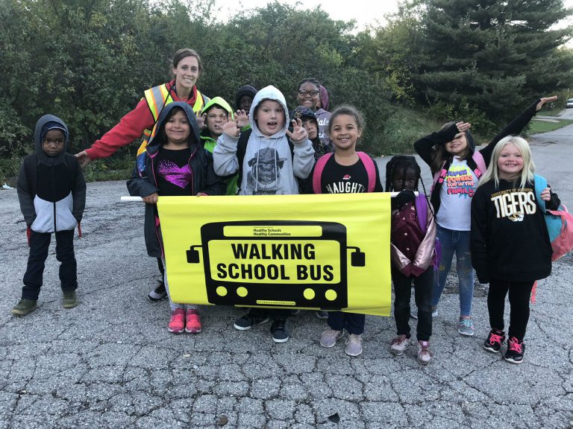
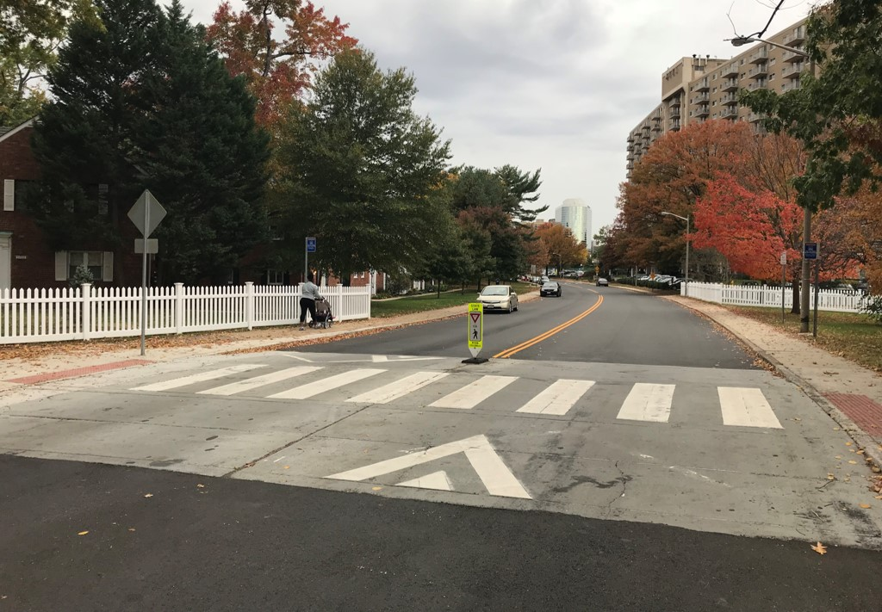
Plan Topics
Transportation and Mobility:
Prioritize safety measures near schools and along primary walking and biking routes to schools.
Improve trail and transit connections to neighboring communities.
Create a strong community identity and prioritize safety for all, when designing intersection and corridor improvements identified as major challenges during the subarea plan process.
Study intersection improvements at: Wagner St./E Colfax, Strasburg Rd./E Colfax, E 26th Ave./Strasburg Rd., E 26th Ave./Piggot Rd., and Piggot Rd./E Colfax.
Install sidewalks along East Colfax Avenue.
Source: walkbiketoschool.org
Source: FHWA
10

Slide 11
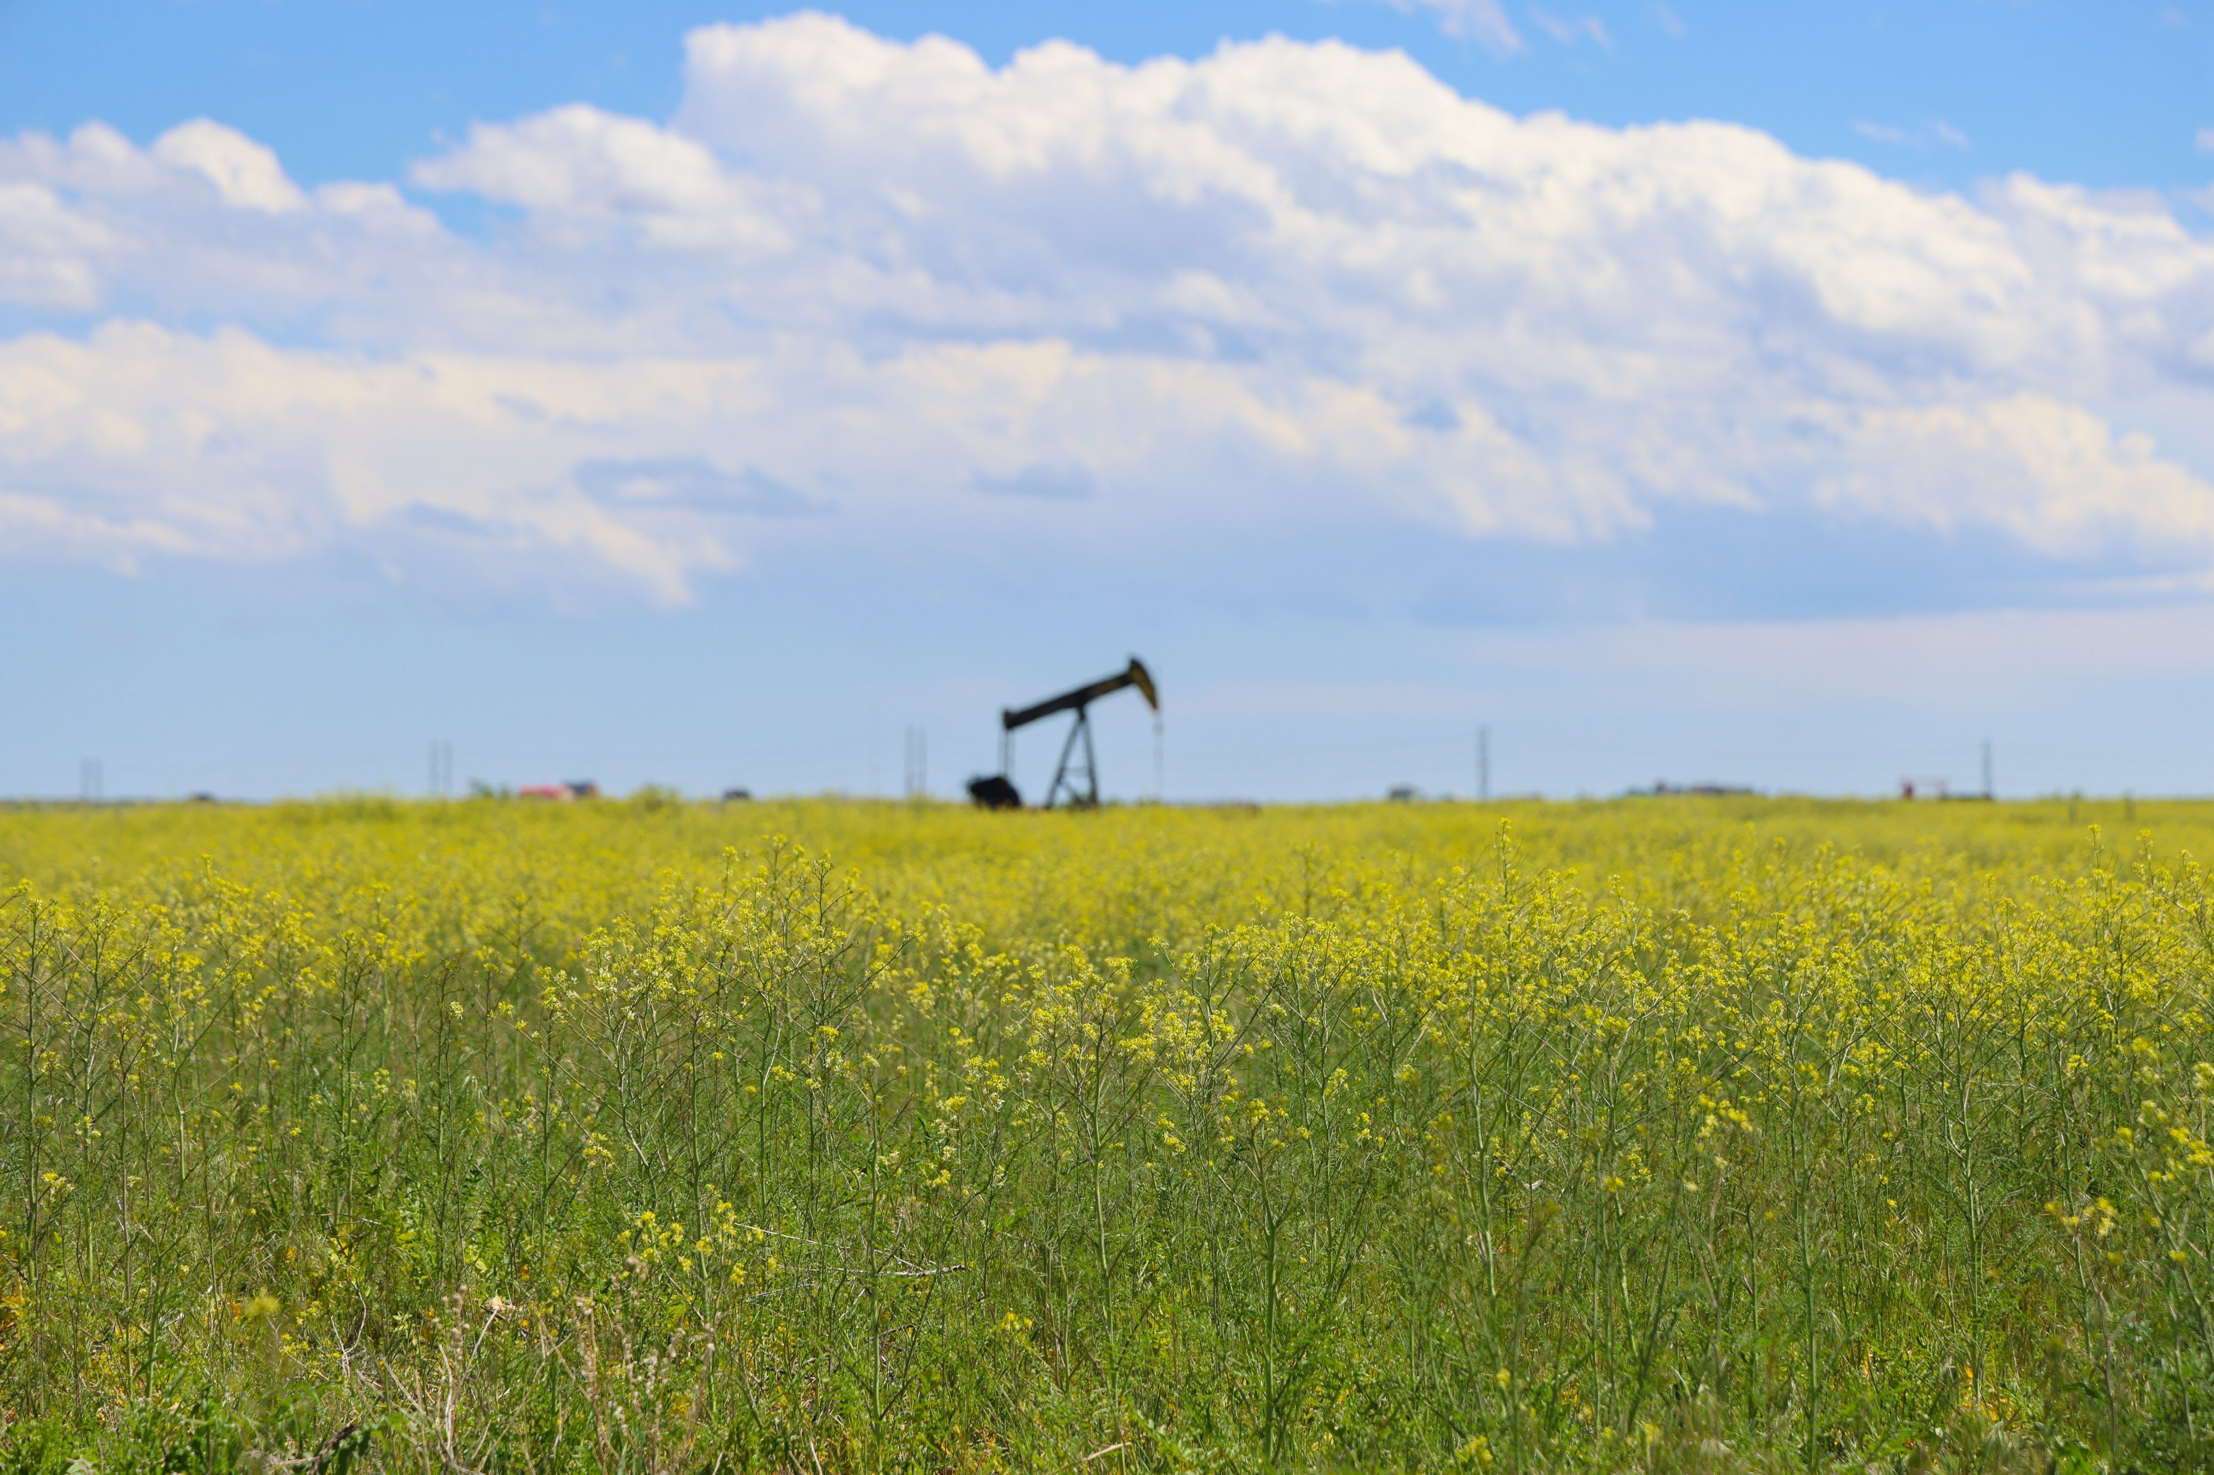
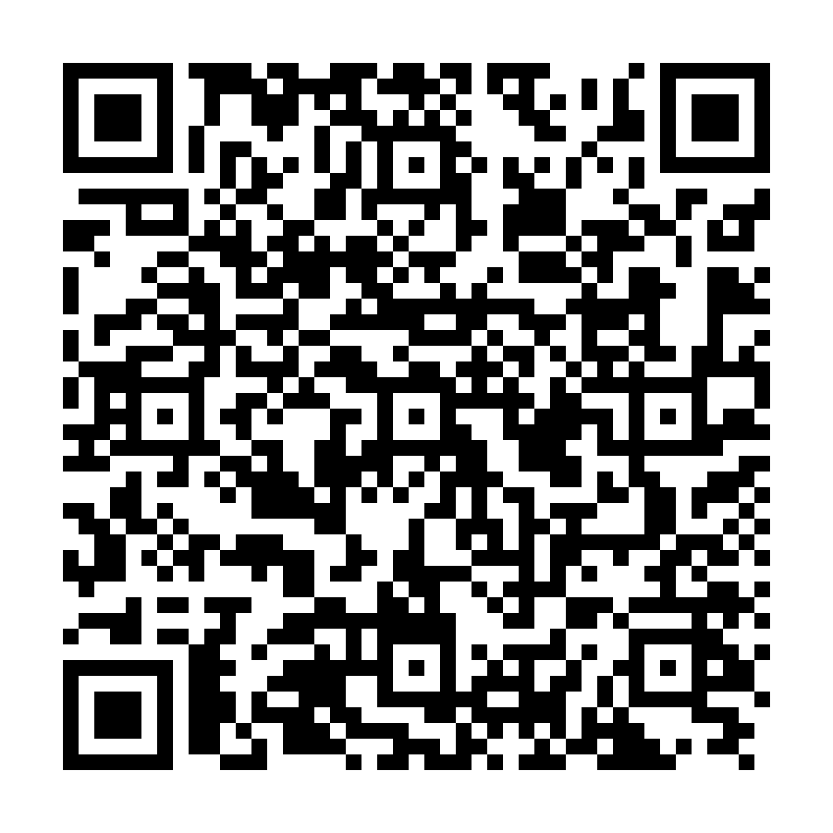
Next Steps
Plan draft will be out for review by the end of July
Community Engagement (come see us at Hometown Days!)
Tentative adoption this fall
Reach out directly to Ella at egleason@adcogov.org or use the code below to access the project website and sign up for updates:
11

