Slide 1


Slide 2
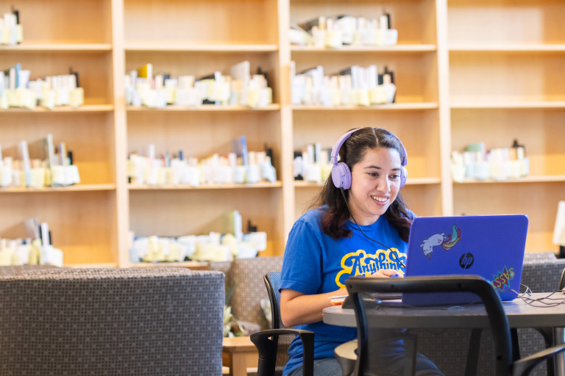

Anythink Libraries
Became a special taxing district in 2009
Rebranded, remodeled and expanded
Focus shifted to innovation, informal learning opportunities and became a values-based organization
We believe in opening doors for curious minds!

Slide 3
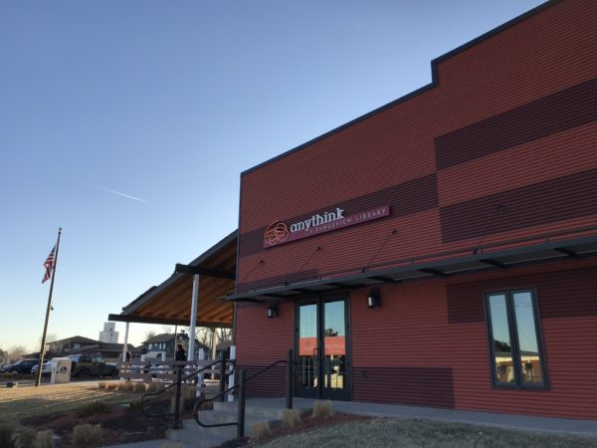
Anythink Bennett
Remodeled in 2009 (the first to be rebranded as Anythink!)
Serves an average of just a little under 8,000 visitors per month!
Circulation is up 30% from the previous year

Slide 4
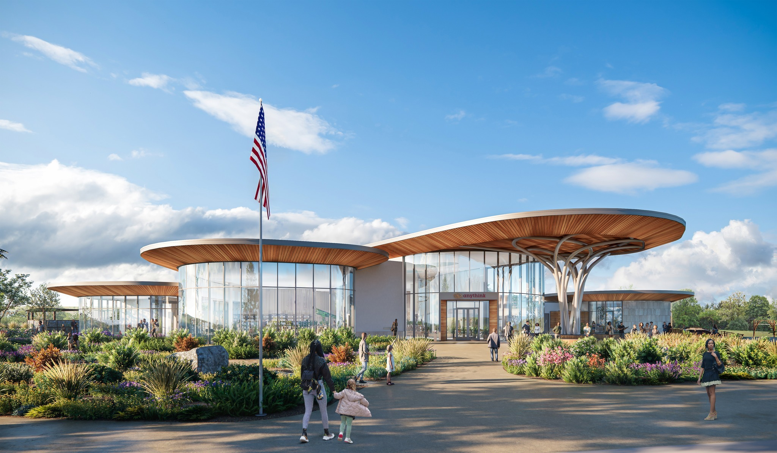
Looking Toward the Future
Anythink Nature Library Opening August 2026. Featuring -Indoor/outdoor programming spaces
Exterior gardens
An open-air kinship garden
A one-mile loop trail
Nature-focused materials and TryIts
A café with indoor/outdoor seating
A trailhead connection to the 140-acre Aylor trail systems
Increased outreach department with the ability to do programming off location and prove services throughout the county meeting people where they are.
Reunion Express Library!

Slide 5

Educator Resources
Free online subscriptions to education resources such as tutor.com, scholastic teachables and more
Continued education resources such as Universal Class and Gale Udemy
Informal learning opportunities through programming and events.
Use the library as a resource for experts and continued learning!

Slide 6

Business Resources
Library staff can assist with business plan creation, market segmentation data access and interpretation, as well as assessing Colorado legal forms and more.
Free printing, laminating, customization at the Anythink Bennett Branch, large scale printers and access to advanced technology resources available at The Studio

Slide 7
Thank you!

